Slide 1
Project 5 : Analyze company’s sales - bookstore chain
JIYEON JANG (JJ)

Slide 2
Table of Contents
Data Visualization (Task 2)
1.1 Customer Analysis
1.2 Product Analysis
1.3 Product & Customer Analysis
1.4 Sales Analysis (over month)
Correlations Analysis (Task 3)
2.1 Gender VS Category of Purchased Products
2.2 Age VS Total Amount of Purchase
2.3 Age VS Purchase Frequency
2.4 Age VS Average Basket Size(in number of items)
2.5 Age VS Category of Purchased Products

Slide 3
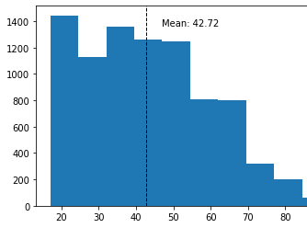
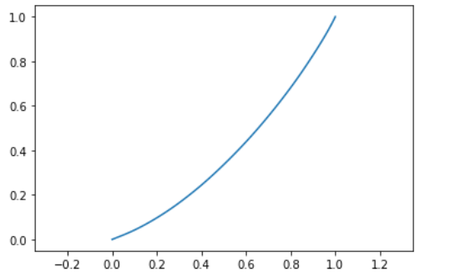
1.1 Customer Analysis – GINI index is approx 0.2

Slide 4
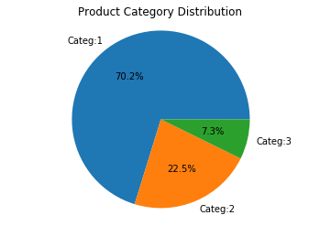
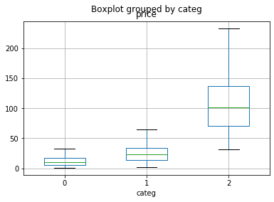
1.2 Product Analysis

Slide 5
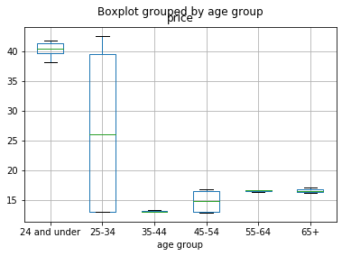
1.3 Product & Customer Analysis

Slide 6
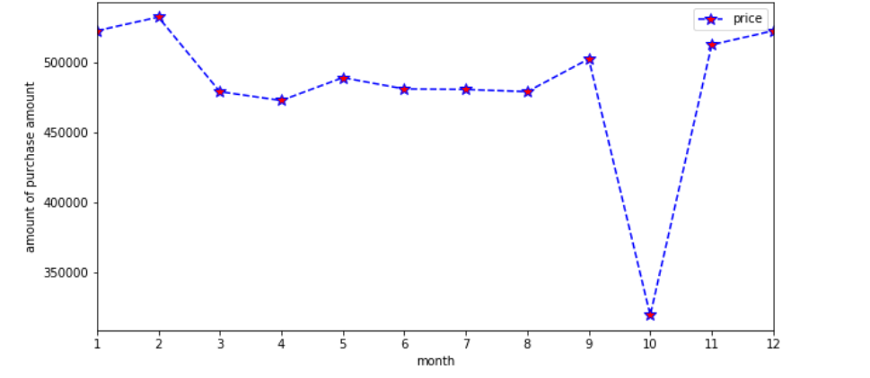
1.4 Sales Analysis (over month)
Notes:
average monthly purchase is 483048.147

Slide 7
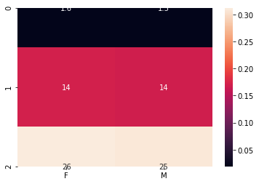
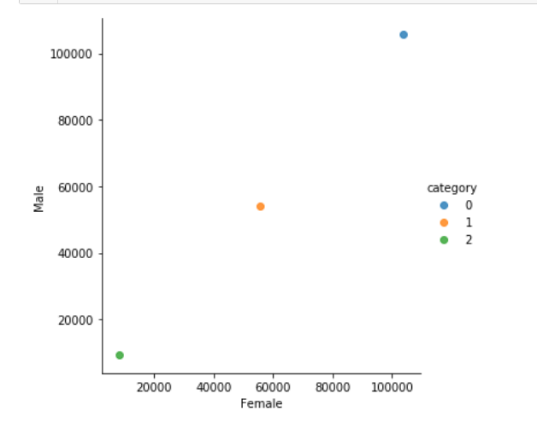
2.1 Gender VS Category of Purchased Products

Slide 8
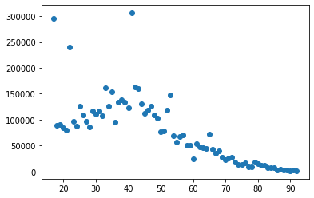
2.2 Age VS Total Amount of Purchase

Slide 9
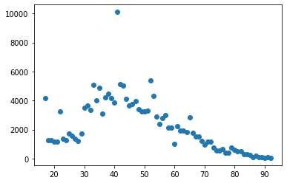
2.3 Age VS Purchase Frequency

Slide 10
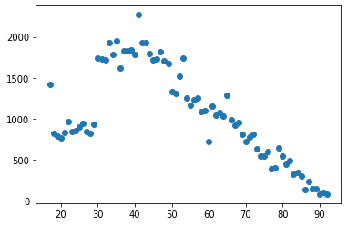
2.4 Age VS Average Basket Size(in number of items)

Slide 11
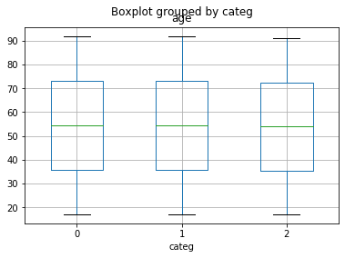
2.5 Age VS Category of Purchased Products
ETA squared is 0.00011591515011011941
We could say there is low correlation between age and category of item they purchase.

